Slide 1
Applied Bioinformatics

Slide 2
Topics covered
Bioconductor
ExpressionSet
Workflows
A simple Bioconductor workflow
Ensembl
Gene Expression Omnibus

Slide 3
Bioconductor

Slide 4

Bioconductor
Bioconductor provides tools for the analysis and comprehension of high-throughput genomic data.
Bioconductor uses the R statistical programming language, and is open source and open development
1741 software packages

Slide 5
Installing Bioconductor
Bioconductor is a repository for thousand over packages for helping do biodata analysis. You do not need to install everything at a go.
Find the relevant package you will need from https://www.bioconductor.org/packages/release/BiocViews.html#___Software.
Run the R console:
## try http:// if https:// URLs are not supported source("https://bioconductor.org/biocLite.R") biocLite(<”Package Name”>)
##Do this to install multiple packages
Biocmanager::install(c("package1","package2"))

Slide 6
ExpressionSet

Slide 7
Bioconductor’s ExpressionSet class
Different platforms e.g. genomics generates biological data with different data organization and different data types
ExpressionSet class is designed to combine many different sources of information into 1 single convenient structure
An ExpressionSet can be manipulated conveniently
An ExpressionSet is the input/output from many BioConductor functions
Notes:
Biobase is part of the Bioconductor project, and is used by many other packages. Biobase contains standardized data structures to represent genomic data. The ExpressionSet class is designed to combine several different sources of information into a single convenient structure. An ExpressionSet can be manipulated (e.g., subsetted, copied) conveniently, and is the input or output from many Bioconductor functions.

Slide 8
ExpressionSet components
assayData
This contains measured information such as expression level of genes
phenoData
This contains the ‘meta-data’ which describes samples in the experiment
featureData
This contains information regarding the technology that generated the data
protocolData
This pertains to the protocol used for processing each sample
experimentalData
This is a loosely structured location for storing descriptions about the experiment
Notes:
the data from many high-throughput genomic experiments, such as microarray experiments, usually consist of several conceptually distinct parts: assay data, phenotypic meta-data, feature annotations and meta-data, and a description of the experiment.
The data in an ExpressionSet is complicated, consisting of expression data from microarray experiments (assayData; assayData is used to hint at the methods used to access different data components, as we will see below), ‘meta-data’ describing samples in the experiment (phenoData), annotations and meta-data about the features on the chip or technology used for the experiment (featureData, annotation), information related to the protocol used for processing each sample (and usually extracted from manufacturer files, protocolData), and a flexible structure to describe the experiment (experimentData). The ExpressionSet class coordinates all of this data, so that you do not usually have to worry about the details

Slide 9
Installation
install.packages("BiocManager")
BiocManager::install("Biobase")
Notes:
The definition of the ExpressionSet class along with many methods for manipulating ExpressionSet objects are defined in the Biobase package.

Slide 10
Converting ExpressionSet from other objects
Raw data may be stored as .CEL files
CEL files are typically associated with microarray expression experiments
Other Bioconductor read functions include ReadAffy, expression or justRMA
You can convert the objects from these read functions into ExpressionSet objects
BiocManager::install("convert")
library(convert)
as(object, “ExpressionSet”)
Notes:
Biobase provides the as function, that will allow you to convert any data file into an Eset file.
It might be the case that no converter is available. The path then is to extract relevant data from object and use this to create an ExpressionSet using the instructions below.

Slide 11
assayData
We will create a data matrix storing the expression information
Suppose your assay data is in a ’tab-delimited’ text file (as exported from a spreadsheet, for instance) with rows corresponding to features and columns to samples
The strategy is to read this file into R using the read.table command, converting the result to a matrix

Slide 12
assayData
dataDirectory <- system.file("extdata", package="Biobase")
exprsFile <- file.path(dataDirectory, "exprsData.txt")
exprs <- as.matrix(read.table(exprsFile, header=TRUE, sep="\t",row.names=1, as.is=TRUE))
class(exprs)
dim(exprs)
colnames(exprs)
head(exprs[,1:5])
minimalSet <- ExpressionSet(assayData=exprs) #minimal Eset
Notes:
The first two lines create a file path pointing to where the assay data is stored; replace these with a character string pointing to your own file, e.g, exprsFile <- "c:/path/to/exprsData.txt”
(Windows users: note the use of / rather than \; this is because R treats the \ character as an ‘escape’ sequence to change the meaning of the subsequent character). See the help pages for read.table for more detail. A common variant is that the character separating columns is a comma (“comma-separated values”, or “csv” files), in which case the sep argument might be sep=",".

Slide 13
phenoData
Phenotypic data summarizes information about the samples (e.g., sex, age, and treatment status; referred to as ‘covariates’).
The information describing the samples can be represented as a table with S rows and V columns, where V is the number of covariates.

Slide 14
phenoData
pDataFile <- file.path(dataDirectory, "pData.txt")
pData <- read.table(pDataFile, row.names=1, header=TRUE, sep="\t")
dim(pData)
rownames(pData)
summary(pData)
all(rownames(pData)==colnames(exprs))
Notes:
There are three columns of data, and 26 rows. Note that the number of rows of phenotypic data match the number of columns of expression data, and indeed that the row and column names are identically ordered:

Slide 15
phenoData
Note that the number of rows of phenotypic data match the number of columns of expression data
This is an essential feature of the relationship between the assay and phenotype data
ExpressionSet will complain if these names do not match.
Phenotypic data can take on a number of different forms. For instance, some covariates might reasonably be represented as numeric values
Other covariates (e.g., gender, tissue type, or cancer status) might better be represented as factor objects

Slide 16
Question time
What class does read.table return?
Determine the column names of pData.
How would you use sapply to determine the classes of each column of pData?
What is the sex and Case/Control status of the 15th and 20th samples? And for the sample(s) with score greater than 0.8?
Notes:
names(pData)
sapply(pData, class)
pData[c(15, 20), c("gender", "type")]
pData[pData$score>0.8,]

Slide 17
phenoData
You can make phenoData more meaningful by creating a data frame that describes what the labels in phenoData actually mean
metadata <- data.frame(labelDescription=c("Patient gender","Case/control status","Tumor progress on XYZ scale"), row.names=c("gender", "type", "score"))
Bioconductor’s Biobase package provides a class called AnnotatedDataFrame that conveniently stores and manipulates the phenotypic data and its metadata in a coordinated fashion.
phenoData <- new("AnnotatedDataFrame",data=pData, varMetadata=metadata)

Slide 18
annotatedDataFrame
Some useful operations on an AnnotatedDataFrame include sampleNames, pData (to extract the original pData data.frame), and varMetadata can also be manipulated like a data frame
AnnotatedDataFrame
head(pData(phenoData))
phenoData[c("A","Z"),"gender"]
pData(phenoData[phenoData$score>0.8,])

Slide 19
featureData
Meta-data on features is as important as meta-data on samples, and can be very large and diverse.
A single chip design (i.e., collection of features) is likely to be used in many different experiments, and it would be inefficient to repeatedly collect and coordinate the same metadata for each ExpressionSet instance.
Instead, the ideas is to construct specialized meta-data packages for each type of chip or instrument.

Slide 20
featureData
Many of these packages are available from Bioconductor
These packages contain information such as the gene name, symbol and chromosomal location
There are other meta-data packages that contain the information that is provided by other initiatives such as GO and KEGG
The annotate and AnnotationDbi packages provides basic data manipulation tools for the meta-data packages

Slide 21
featureData
To create annotation data for features is very straight-forward, we provide a character string identifying the type of chip used in the experiment
For instance, the data we are using is from the Affymetrix hgu95av2 chip:
annotation <- "hgu95av2"

Slide 22
experimentalData
Basic description about the experiment (e.g., the investigator or lab where the experiment was done, an overall title, and other notes) can be recorded by creating a MIAME object.
MIAME stands for “minimum information about a microarray experiment”
One way to create a MIAME object is to use the new() function:

Slide 23
experimentalData
experimentData <- new("MIAME",name="Pierre Fermat",lab="Francis Galton Lab",
contact="pfermat@lab.not.exist",
title="Smoking-Cancer Experiment",
abstract="An example ExpressionSet",
url="www.lab.not.exist",
other=list(
notes="Created from text files"
))

Slide 24
Putting together ExpressionSet
An ExpressionSet object is created by assembling its component parts and callng the ExpressionSet constructor:
exampleSet <- ExpressionSet(assayData=exprs,phenoData=phenoData,experimentData=experimentData,annotation="hgu95av2")

Slide 25
Doing things with ExpressionSet
To get an overview of the structure and available methods for ExpressionSet objects
help("ExpressionSet-class")
When you print an ExpressionSet object, a brief summary of the contents of the object is displayed (displaying the entire object would fill your screen with numbers):
exampleSet

Slide 26
Accessing elements in ExpressionSet
A number of accessor functions are available to extract data from an ExpressionSet instance. You can access the columns of the phenotype data (an AnnotatedDataFrame instance) using $:
exampleSet$gender[1:5]
You can retrieve the names of the features using featureNames. For many microarray datasets, the feature names are the probe set identifiers.
featureNames(exampleSet)[1:5]
The unique identifiers of the samples in the data set are available via the sampleNames method:
sampleNames(exampleSet)[1:5]
The varLabels method lists the column names of the phenotype data:
varLabels(exampleSet)
To extract the expression matrix of sample information we use exprs:
mat <- exprs(exampleSet)

Slide 27
Subsetting ExpressionSet
Subsetting allows us to retrieve only the interesting parts of the data
Subsetting an ExpressionSet is very similar to subsetting the expression matrix that is contained within the ExpressionSet
The first argument subsets the features and the second argument subsets the samples
To create a new ExpressionSet consisting of the 5 features and the first 3 samples:
vv <- exampleSet[1:5, 1:3]
dim(vv)

Slide 28
Subsetting ExpressionSet
To create a subset consisting of only the male samples:
males <- exampleSet[ , exampleSet$gender == "Male"]

Slide 29
Workflows

Slide 30
Workflow
A workflow is an ordered series of programmes for performing a task
Analysis of biological data requires “shepherding” files through a series of programmes, called a pipeline or a workflow.

Slide 31
What are the options?
A series of scripts designed to work in tandem (controlled using unix shellscript)
Basically a set of unix commands saved in a file for convenience
Do task 1 <input> <output>
Do task 2 <input> <output>
Do task 3 <input> <output> <arg 1> <arg 2>
Each task is written as a separate program.
In this example, the output of 1 task, is the input of another.
You can also specify arguments (arg1, arg2, …) to the scripts controlling each task so as to change the behaviors or analysis parameters.
For example, suppose task 3 is a statistical analysis tool. Arg 1 is the statistical threshold, so we can set the value of arg 1 to 0.05 or 0.01.
R scripts can be executed in Unix sequentially using the Rscript command

Slide 32
What are the options?
A graphical user interface (GUI) for controlling sequence and behaviors
Notes:
A GUI can be used as a wrapper on top of your programs.
Each node is a standalone program or module that carries out a specific function. And each node would have arguments to allow for modulation of the program’s behaviors.
The “connections” shown as arrows specify the direction of data flow. In this case, there are several layers of input. The input file for the data of interest, and a library file shown at the top in fasta format.
The data undergoes several steps of transformations until it reaches node 8, which creates an output.
The nice part about GUIs is that they are quite intuitive, and can be built to be aesthetically pleasing. However, this option does not always exist given what you want to do. It also requires a large and competent group of developers to maintain.

Slide 33
What are the options?
A library of tools that can be executed within 1 script.
Line 1: x <- Function 1(<data>, args 1, args 2,)
Line 2: y <- Function 2(x, args 1, args 2,)
Line 3: z <- Function 3(y, args 1, args 2,)
This is a self-contained script calling a series of functions within R itself (without using the Unix command line). Similar to the Unix shellscript, it also involves calling a series of functions with the output of 1 line becoming the input of the next line.

Slide 34
Workflows
https://bioconductor.org/help/workflows/
http://master.bioconductor.org/packages/release/workflows/vignettes/sequencing/inst/doc/sequencing.html
https://master.bioconductor.org/packages/release/workflows/vignettes/proteomics/inst/doc/proteomics.html
http://master.bioconductor.org/packages/release/workflows/vignettes/rnaseqGene/inst/doc/rnaseqGene.html
http://master.bioconductor.org/packages/release/workflows/vignettes/arrays/inst/doc/arrays.html

Slide 35
Proteomics workflow

Slide 36
The objectives of proteomics

Slide 37
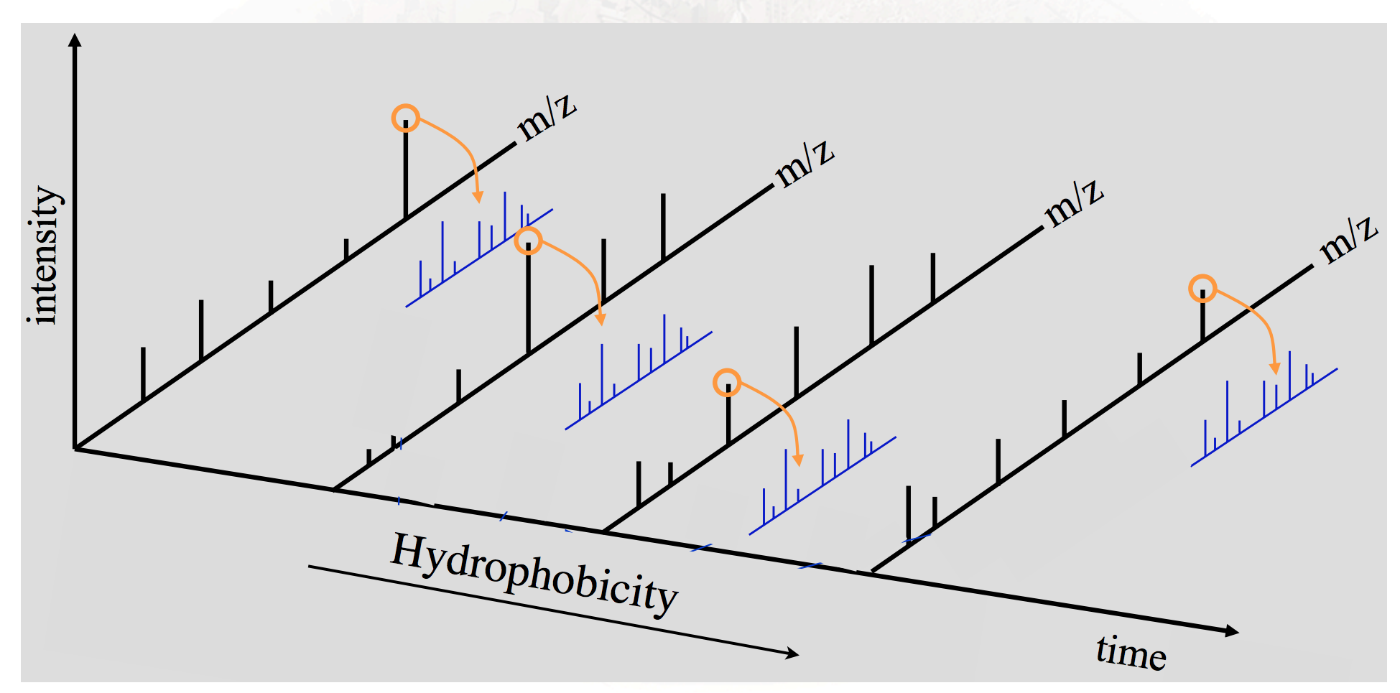
The layout of the data
There is a one-to-one correspondence between each MS1 and MS2
MS1
MS² or MS/MS
Retention time

Slide 38
Installing the R Bioconductor proteomics pipeline
Getting everything at one shot
library("BiocInstaller")
biocLite("RforProteomics", dependencies = TRUE)
If you want to try doing it individually
biocLite(c("mzR",
"mzID",
"MSnID",
"MSnbase",
"rpx",
"MLInterfaces",
"pRoloc",
"pRolocdata",
"MSGFplus",
"rols",
"hpar”), dependencies = TRUE)

Slide 39
First we load into memory all the libraries we need
library("mzR")
library("mzID")
library("MSnID")
library("MSnbase")
library("rpx")
library("MLInterfaces")
library("pRoloc")
library("pRolocdata")
library("MSGFplus")
library("rols")
library("hpar")

Slide 40
So what can this pipeline do?
Exploring available infrastructure
Mass spectrometry data
Getting data from proteomics repositories
Handling raw MS data
Handling identification data
MS/MS database search
Analysing search results
High-level data interface
Quantitative proteomics
Importing third-party quantitation data
Data processing and analysis
Statistical analysis
Machine learning
Annotation
Other relevant packages/pipelines

Slide 41
Exploring available infrastructure
In Bioconductor version 3.7, there are respectively 105 proteomics, 69 mass spectrometry software packages and 19 mass spectrometry experiment packages. These respective packages can be extracted with the proteomicsPackages(), massSpectrometryPackages() and massSpectrometryDataPackages() and explored interactively.
library("RforProteomics")
pp <- proteomicsPackages()
display(pp)

Slide 42
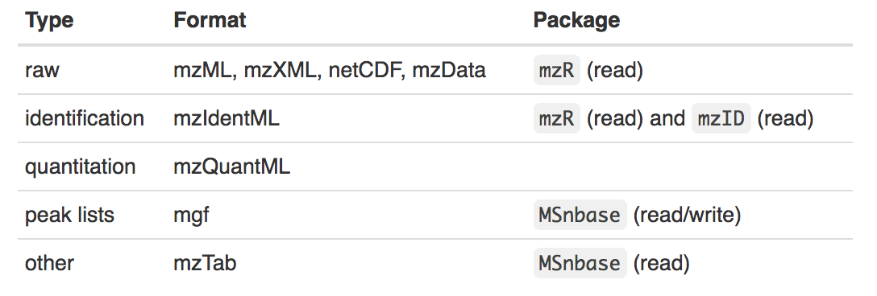
Mass spectrometry data
R/Bioconductor supports many open access formats

Slide 43
Obtaining data from database
The rpx is an interface to ProteomeXchange (PX) and provides a basic access to its data. PX is a massive proteomics database which also takes data from PRIDE, PASSEL and MassIVE.
library("rpx")
pxannounced()
## 15 new ProteomeXchange announcements
## Data.Set Publication.Data Message
## 1 PXD008710 2018-04-25 07:30:20 Updated information
## 2 PXD008376 2018-04-25 07:25:40 New
## 3 PXD006838 2018-04-25 07:19:31 New
## 4 PXD006836 2018-04-25 07:12:42 New
## 5 PXD002273 2018-04-25 07:07:05 New
…

Slide 44
Obtaining data from database
metadata can be retrieved remotely using the PXDataset() function and calling its specific identifier e.g. PXD000001.
px <- PXDataset("PXD000001")
px #to find out what is in there
## Object of class "PXDataset"
## Id: PXD000001 with 12 files
## [1] 'F063721.dat' ... [12] 'generated' ## Use 'pxfiles(.)' to see all files.
Notes:
Meta data is data that describes data e.g. who produced it. Or what is this dataset about.

Slide 45
Obtaining data from database
pxfiles(px) #take a look at the specific files inside (those 12)
## [1] "F063721.dat"
## [2] "F063721.dat-mztab.txt"
## [3] "PRIDE_Exp_Complete_Ac_22134.xml.gz"
## [4] "PRIDE_Exp_mzData_Ac_22134.xml.gz"
## [5] "PXD000001_mztab.txt"
## [6] "README.txt"
## [7] "TMT_Erwinia_1uLSike_Top10HCD_isol2_45stepped_60min_01-20141210.mzML" ##
[8] "TMT_Erwinia_1uLSike_Top10HCD_isol2_45stepped_60min_01-20141210.mzXML" ##
…

Slide 46
Obtaining data from database
Data files can then be downloaded with the pxget function.
The file is downloaded into the working directory and the name of the file is return by the function and stored in the mzf variable for later use.
fn <-"TMT_Erwinia_1uLSike_Top10HCD_isol2_45stepped_60min_01-20141210.mzML"
mzf <- pxget(px, fn)
## Downloading 1 file
mzf
## [1] "/tmp/RtmpSUTMZy/Rbuild77de6f913a8c/proteomics/vignettes/TMT_Erwinia_1uLSike_Top10HCD_isol2_45stepped_60min_01-20141210.mzML"

Slide 47
Handling raw MS data
The mzR package is useful for reading raw MS formats including mzML, mzXML, netCDF, and mzData
The three main functions are openMSfile to create a file handle to a raw data file, header to extract metadata about the spectra contained in the file and peaks to extract one or multiple spectra of interest.
library("mzR")
ms <- openMSfile(mzf)
ms
## Mass Spectrometry file handle.
## Filename: TMT_Erwinia_1uLSike_Top10HCD_isol2_45stepped_60min_01-20141210.mzML
## Number of scans: 7534
The header function returns the metadata of all available peaks:
hd <- header(ms) dim(hd)
## [1] 7534 25
Notes:
25 dimensions of information for each scan.

Slide 48
Handling raw MS data
names(hd)
## [1] "seqNum" "acquisitionNum"
## [3] "msLevel" "polarity"
## [5] "peaksCount" "totIonCurrent"
## [7] "retentionTime" "basePeakMZ"
## [9] "basePeakIntensity" "collisionEnergy"
## [11] "ionisationEnergy" "lowMZ"
## [13] "highMZ" "precursorScanNum"
## [15] "precursorMZ" "precursorCharge"
## [17] "precursorIntensity" "mergedScan"
## [19] "mergedResultScanNum" "mergedResultStartScanNum"
## [21] "mergedResultEndScanNum" "injectionTime"
## [23] "filterString" "spectrumId"
## [25] "centroided"

Slide 49
Handling raw MS data
Extract metadata and scan data for scan 1000 by simply calling it by its row.
hd[1000, ]
## seqNum acquisitionNum msLevel polarity peaksCount totIonCurrent
## 1000 1000 1000 2 1 274 1048554
## retentionTime basePeakMZ basePeakIntensity collisionEnergy ## 1000 1106.916 136.061 164464 45
## ionisationEnergy lowMZ highMZ precursorScanNum precursorMZ ## 1000 0 104.5467 1370.758 992 683.0817
## precursorCharge precursorIntensity mergedScan mergedResultScanNum
## 1000 2 689443.7 0 0
## mergedResultStartScanNum mergedResultEndScanNum injectionTime
## 1000 0 0 55.21463
## filterString
…

Slide 50
Handling raw MS data
head(peaks(ms, 1000))
## [,1] [,2]
## [1,] 104.5467 308.9326
## [2,] 104.5684 308.6961
## [3,] 108.8340 346.7183
## [4,] 109.3928 365.1236
## [5,] 110.0345 616.7905
## [6,] 110.0703 429.1975

Slide 51
Handling raw MS data
plot(peaks(ms, 1000), type = "h")

Slide 52
Extracting and plotting a slice of MS data
## a set of spectra of interest: MS1 spectra eluted
## between 30 and 35 minutes retention time
ms1 <- which(hd$msLevel == 1)
rtsel <- hd$retentionTime[ms1] / 60 > 30 & hd$retentionTime[ms1] / 60 < 35
## the map
M <- MSmap(ms, ms1[rtsel], 521, 523, .005, hd)
data
rt range
mz range
header
Notes:
Time is recorded as seconds. Divided by 60 to convert to minutes

Slide 53
Extracting and plotting a slice of MS data
plot(M, aspect = 1, allTicks = FALSE)

Slide 54
Extracting and plotting a slice of MS data
plot3D(M)

Slide 55
Processing raw data
Raw data
MS/MS database search
Analyze search results
Quantitation
Processing data is a lot of work. And requires very specific knowledge
on formats, appropriate algorithms and reasonable parameters
Even if we do know what needs to be done at each step/layer, knowing how to use the software packages isn’t necessarily so straightforward
Bioconductor workflows helps to ease some of the knowledge-practice gap

Slide 56
Proteomics data has many layers
Raw
Data and metadata generated by mass spectrometers
Standardised MS data formats
Represent processed peak lists, as well as raw data. In addition to the mass spectra, they contain detailed metadata that gives context to the information.
Processed peak lists
Heavily processed
The data may be the original profile mode scans or may already have had some basic processing
mzML
Binary output
These files are formatted in plain text, with typical formats like dta, pkl, ms2 or mgf.
Search engine output
engines used for performing the identification and quantification of peptides and proteins.
mzIdentML - provides a common format for the export of identification results from any search engine.
mzTab - represents both identification and basic quantification results.

Slide 57
Proteomics data has many layers
Peptide identifications
Proteomics mass spectra can be matched to peptides or proteins, resulting in identifications for those spectra.
Protein identifications
The protein assembly step can be a discernible process with its own input and output files, or it can be implicit in the overall identification software.
Typically a spectrum is considered to have been identified if the score attributed to a peptide or protein match qualifies against an a priori or a posteriori defined threshold
Meta-data
Protein/peptide quantification
Protein/peptide expression values can also be obtained from an MS-­based proteomics experiment and then this data and metadata is used for performing the quantification analysis of peptides and proteins.
Data that provides additional information about a particular data set. This information can include how, when and where the data set was generated and what standards were used.

Slide 58
Importing third-party quantitation data
In most cases, especially as biologists, you usually won’t work directly with raw data.
The PSI mzTab file format is aimed at providing a simpler (than XML formats) and more accessible file format to the wider community.
mztf <- pxget(px, "F063721.dat-mztab.txt")
(mzt <- readMzTabData(mztf, what = "PEP", version = "0.9"))
## MSnSet (storageMode: lockedEnvironment)
## assayData: 1528 features, 6 samples
## element names: exprs
## protocolData: none
## phenoData
## sampleNames: sub[1] sub[2] ... sub[6] (6 total)
## varLabels: abundance
## varMetadata: labelDescription ## featureData ## featureNames: 1 2 ... 1528 (1528 total)
…
Notes:
Mztab is composed of a key-value metadata section and peptide/protein/small molecule tabular sections.
Under what you can specify PEP for peptides or PRT for proteins.
testfile <- "https://raw.githubusercontent.com/HUPO-PSI/mzTab/master/legacy/jmztab-1.0/examples/mztab_itraq_example.txt"
prot <- readMzTabData_v0.9(testfile, "PRT")
attributes(prot)

Slide 59
Importing third-party quantitation data
The mzTab format is not intended to store the complete experimental evidence but provides mechanisms to report results at different levels of detail. These range from a simple summary of the final results to a representation of the results including the experimental design.
https://www.ncbi.nlm.nih.gov/pubmed/24980485

Slide 60
Ensembl

Slide 61
What is Ensembl?
Ensembl is a joint project between the European Bioinformatics Institute (EBI) and the Wellcome Trust Sanger Institute
Ensembl seeks to develop an automated system for the production and maintenance of annotations on eukaryotic genomes
These annotations should also be easily accessible to researchers

Slide 62
What is Ensembl?
While originally developed for eukaryotes, the Ensembl system has also been used to analyze prokaryotic genomes
EBI Genome Review (archaea and bacteria)
Versions are regularly updated e.g. v97 (Jul 2019)
Genomes available include human, chimp, mouse, dog, C. elegans, fruit fly, honey bee, mosquito among others

Slide 63
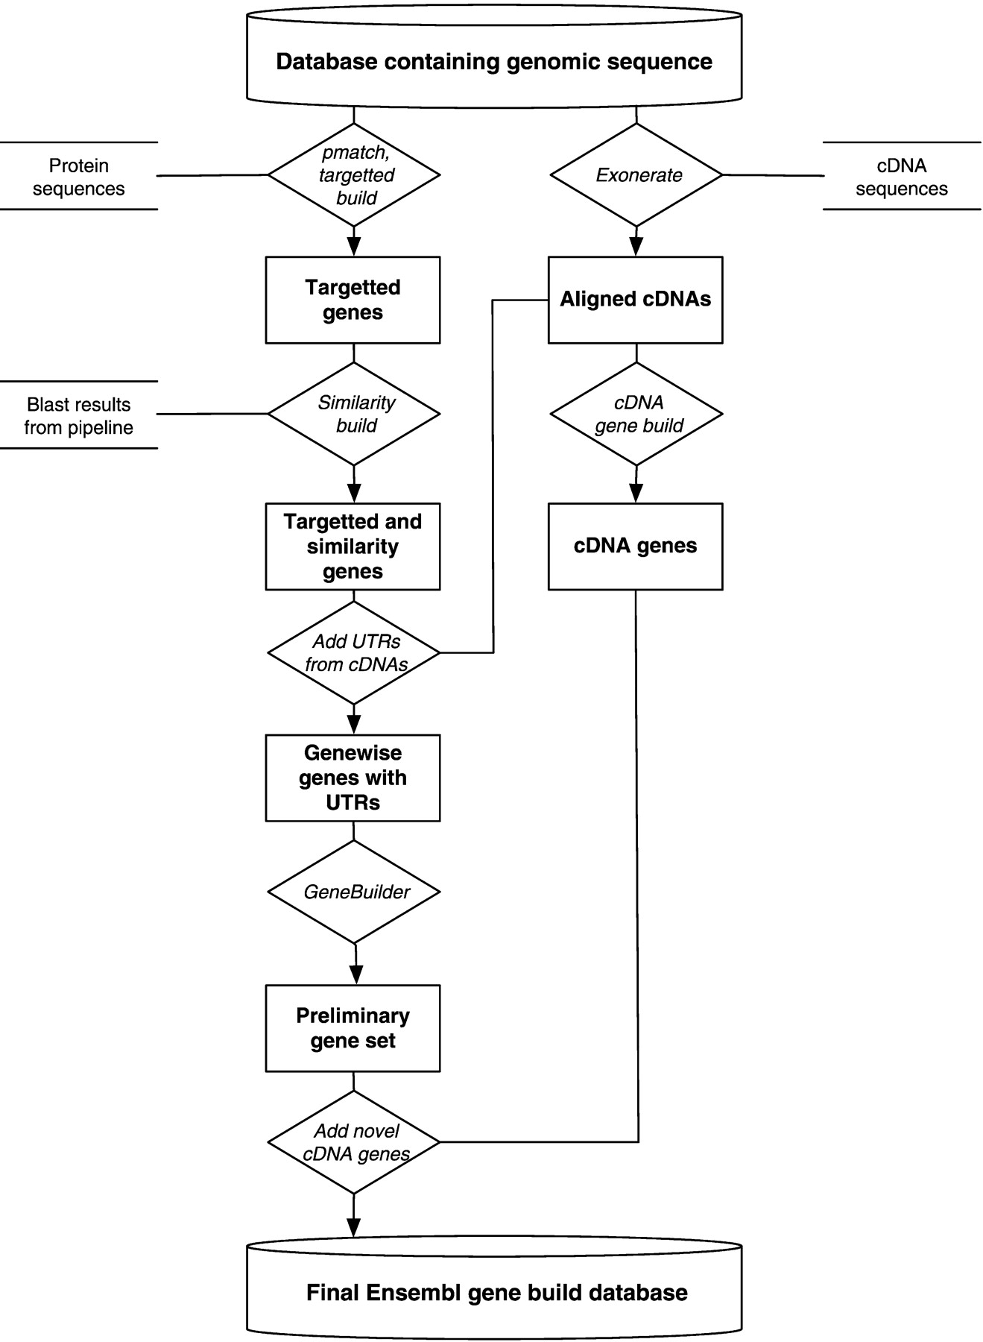
Ensembl Gene Annotation System
All Ensembl gene predictions are based on experimental evidence
Predictions based on manually curated Uniprot/Swissprot/Refseq databases
UTR’s are annotated only if they are supported by EMBL mRNA records

Slide 64
Why the need for Ensembl?
In recent years a wealth of biological data has become available in public data repositories.
Easy access to these valuable data resources and firm integration with data analysis is needed for comprehensive bioinformatics data analysis.

Slide 65
Things you can do with Ensembl
View genes along with other annotation along the chromosome
View alternative transcripts (including splice variants) for a gene
Explore homologues and phylogenetic trees across more than 40 species for any gene
Compare whole genome alignments and conserved regions across species
View microarray sequences that match to Ensembl genes
View ESTs, clones, mRNA and proteins for any chromosomal region
Examine single nucleotide polymorphisms (SNPs) for a gene or chromosomal region
View SNPs across strains (rat, mouse), populations (human), or even breeds (dog)
View positions and sequence of mRNA and protein that align with an Ensembl gene
Upload your own data
Use BLAST, or BLAT, a similar sequence alignment search tool, against any Ensembl
genome
Export sequence, or create a table of gene information with BioMart

Slide 66
Retrieving data from Ensembl (BioMart)
BioMart (www.biomart.org) is a very popular web-interface that can extract information from the Ensembl databases and present the user with a table of information without the need for programming.
It can be used to output sequences or tables of genes along with gene positions (chromosome and base pair locations), single nucleotide polymorphisms (SNPs), homologues, and other annotation in HTML, text, or Microsoft Excel format.
BioMart can also translate one type of ID to another, identify genes associated with an InterPro domain or gene ontology (GO) term, export gene expression data and lots more
Notes:
A popular interface that extracts genes and associated annotation from the database and presents it as formatted tables in Microsoft Excel, HTML or txt in response to the user’s specification. Flexible and fast, BioMart can also be used to export sequences, or to connect information across different databases. See module 5.

Slide 67
Retrieving data from Ensembl (Bioconductor)
biomaRt provides an interface to a growing collection of databases implementing the BioMart software suite ().
The package enables retrieval of large amounts of data in a uniform way without the need to know the underlying database schemas or write complex SQL queries.
The most prominent examples of BioMart databases are maintained by Ensembl, which provides biomaRt users direct access to a diverse set of data and enables a wide range of powerful online queries from gene annotation to database mining.

Slide 68
GEO

Slide 69
What is GEO?
GEO stands for Gene Expression Omnibus
GEO is an international public repository that archives and freely distributes microarray, next-generation sequencing, and other forms of high-throughput functional genomics data submitted by the research community.

Slide 70
The 3 main goals of GEO are
Provide a robust, versatile database in which to efficiently store high-throughput functional genomic data (see Data organization)
Offer simple submission procedures and formats that support complete and well-annotated data deposits from the research community (see Submission guide)
Provide user-friendly mechanisms that allow users to query, locate, review and download studies and gene expression profiles of interest (see Query and analysis)

Slide 71
Using GEO
GEO data can be retrieved and analyzed in several ways
To look at a particular GEO record for which you have the accession number, use the GEO accession boxlocated on the GEO homepage or at the top of each GEO record.
To download data, see the various options described on the Download GEO data page.
To quickly locate data relevant to your interests, search GEO DataSets and GEO Profiles:

Slide 72
GEO DataSets
GEO DataSets is a study-level database which users can search for studies relevant to their interests.
The database stores descriptions of all original submitter-supplied records, as well as curated DataSets.
More information about GEO DataSets and how to interpret GEO DataSets results pages can be found on the About GEO DataSets page.

Slide 73
GEO Profiles
GEO Profiles is a gene-level database which users can search for gene expression profiles relevant to their interests.
More information about GEO Profiles and how to interpret GEO Profiles results pages can be found on the About GEO Profiles page.

Slide 74
Data analysis on GEO
Once you have identified a DataSet of interest there are several features on the DataSet record that help identify interesting gene expression profiles within that study, including a t-test tool and clusters. Full information about these features is provided on the About GEO DataSets page.
Once you have identified gene expression profiles of interest there are several links on the Profile records that help identify additional genes of interest, including similarly expressed genes or genes within close proximity on the chromosome. Full information about these links is provided on the About GEO Profiles page.

Slide 75
Important acronyms in GEO
GSE – Data Series
GDS - Datasets
GPL - Platform
GSM - Sample

Slide 76
GEOquery
Allows you to download data directly from GEO into R
library(GEOquery)
geoD<- getGEO(‘GSE6324’) # processed data
cels<- getGEOSuppFiles(‘GSE6324 ‘) # raw data

Slide 77
ArrayExpress
Sister site of GEO
AE take data from GEO, and implement MIAME more stringently
AE has nice browser interface
Many datasets are in Gene Expression Atlas (GXA) which is a fab resource with a nice API
The updates from GEO are less frequent now. It is uncertain we need several data repositories

Slide 78
ArrayExpress
Download directly from ArrayExpress
> library (ArrayExpress)
#queries the ArrayExpress database with keywords
> queryAE(“breast”)
> arrayexpress("E-TABM-1“)

Slide 79
ArrayExpress
AEData<-getAE("E-TABM-1", type = "processed")
AERawData<-getAE("E-TABM-1", type = “raw")
AERawData<-getAE("E-TABM-1", type = “full")

Slide 80
Analyzing biological data

Slide 81
Challenges
Genome scale data
10,000’s variables
Multivariate
Essential to use exploratory data analysis to “get handle” on data

Slide 82
Always explore data first
Detect unpredicted patterns in data
Decide what questions to ask
Can also help detect confounding covariates

Slide 83

A confounder is…
A confounder is a variable that can create spurious associations.
Let’s say you want to study whether eating sweets causes lung cancer. You only have smokers in your “eating sweets” category, and non-smokers in your “non-sweet eating” category, whether or not someone smokes then becomes a confounding variable (your study is likely to identify a spurious link between sweet eating and lung cancer).
A confounder is also referred to as a lurking variable in statistics.

Slide 84
Why should we care about confounders in bio data science?
Clinical/Biology samples are complex, and are different in many unexpected ways.
Imbalance in any of these ways (variables) may lead towards unexpected correlations (Anna Karenina Effect).
They may also lead towards non-detection of true signal (Loss of power).
Poor experimental design can lead towards horrifying situations where the variable of interest is completely entangled with a confounder (and cannot be disambiguated) --- this scenario is called perfect confounding.

Slide 85
The Idea of Perfect Confounding
Let’s say we want to know if drinking Yakult makes you taller. We design the following experiment:
Yakult Drinkers
Non-Yakult Drinkers
What is wrong here?

Slide 86
The Idea of Perfect Confounding
Yakult drinkers being tested are all male.
Males are in general, taller than females.
Therefore, we are likely to observe that Yakult drinkers are taller and therefore conclude that a correlation exists.
However, we cannot say for sure (do not forget that Yakult is full of milk calcium and nutrition and can in fact, aid growth).
In this case, because the Yakult and gender variables are completely mixed together in the same category, we cannot disentangle them. This situation is known as “perfect confounding”.
Note that not all unbalanced variables are confounders. The unbalanced variable must contribute towards the outcome of interest. For example, if the Yakult drinking group is composed entirely of biology students on one hand, and engineering students on the other, you may not care as much.

Slide 87
Remedies
Balanced Design
Remove the Confounder
Yakult Drinkers
Non-Yakult Drinkers
Yakult Drinkers
Non-Yakult Drinkers
In your opinion, which approach is better? Which approach is more feasible in real world practice?

Slide 88
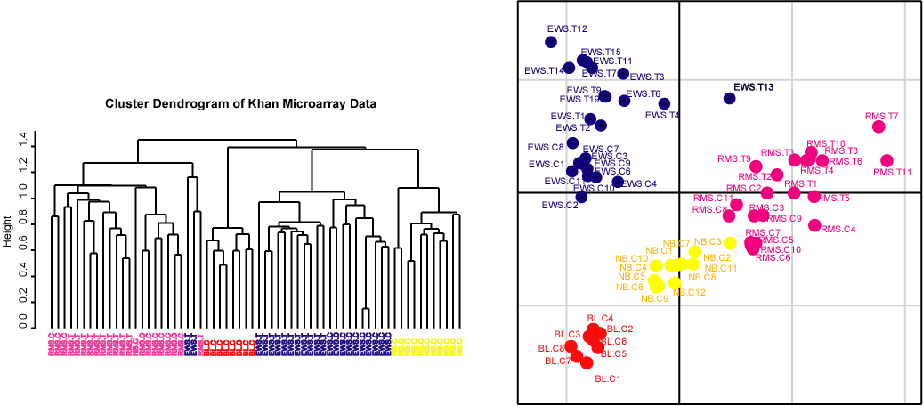
Exploration of data is critical
Clustering
Hierarchical
Flat (k-means)
Ordination (Dimension Reduction)
Principal Component analysis, Correspondence analysis
But this is a tale for another day…

Slide 89
End of Segment

